Slide 1




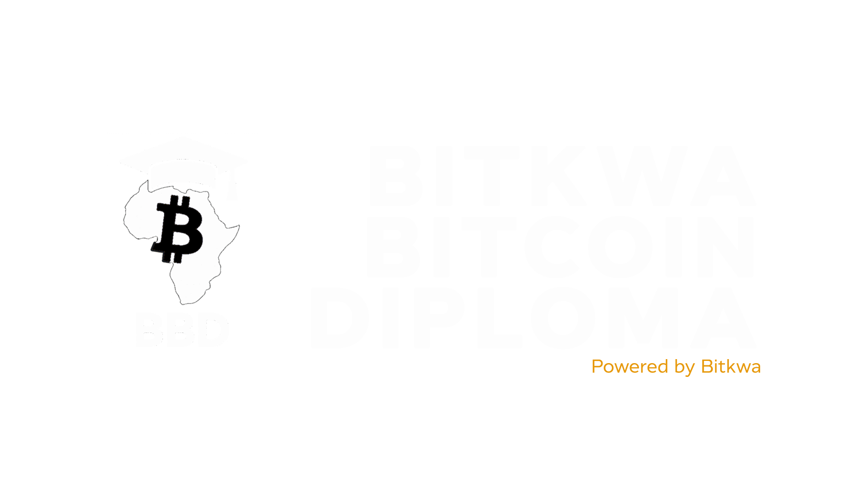


Slide 2
Chapter #6
Bitcoin for Activism
(Privacy & Human Rights)

Slide 3



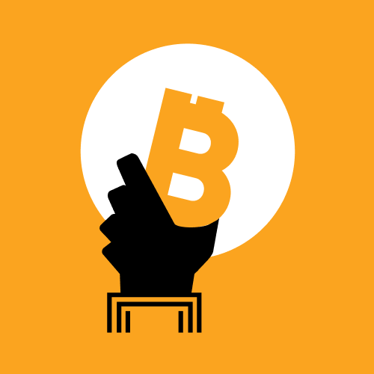
Bitcoin for Activism (Privacy & Human Rights)
Introduction
For people living under authoritarianism or economic mismanagement, Bitcoin can be a lifeline, a way to preserve freedom when traditional systems are used against them.
Alex Gladstein
Why Money is Both a Tool of Oppression and Liberation
In Africa, money has always been more than just a medium of exchange, it’s a mirror of power, control, and freedom. The same financial systems that enable trade and development are often used by those in authority to suppress dissent, limit movement, and silence opposition.
In many African nations, access to financial tools is a privilege, not a right. Governments and financial institutions decide who can send, receive, or store money. When activists, journalists, or citizens challenge corruption or abuse, their financial access becomes the first casualty.

Slide 4
Bitcoin for Activism (Privacy & Human Rights)
Money as a Tool of Oppression
Money as a Tool of Liberation
Account Freezes & Surveillance: During Nigeria’s #EndSARS protests (2020), authorities froze the bank accounts of protest organizers, crippling their ability to receive donations and coordinate logistics.
Inflation & Currency Manipulation: In Zimbabwe and Sudan, years of hyperinflation destroyed citizens’ savings. Governments printed money recklessly, turning hard-earned value into worthless paper.
Cross-border Restrictions: In countries like Ethiopia and Cameroon, strict capital controls prevent citizens from freely sending or receiving funds, isolating them economically.
Aid & NGO Restrictions: Human rights groups in countries such as Uganda and DRC often face frozen accounts or “anti-terrorism” laws used as excuses to restrict their operations.
These examples show how money is used as a weapon, to monitor, control, and weaken communities that question authority.
Despite these challenges, money can also be a tool for empowerment. When individuals have access to a form of money they truly control, they gain the ability to act, resist, and rebuild.
With money that cannot be frozen, activists can sustain their causes.
With money that cannot be devalued by corruption, families can preserve their savings.
With money that can cross borders instantly, communities can support each other directly.
Financial freedom is not only an economic concept, it’s a human right. Without control over one’s money, every other freedom becomes fragile.

Slide 5

Bitcoin for Activism (Privacy & Human Rights)
Bitcoin’s Role as Neutral, Censorship-Resistant Money
Bitcoin emerged as a direct response to the failures of centralized finance. It is neutral, borderless, and permissionless, qualities that make it especially valuable in regions where financial oppression is part of everyday life.
Unlike banks, governments, or fintech companies, Bitcoin does not discriminate.
It does not ask for identification or political allegiance.
It does not close accounts or freeze balances.
It does not stop working when a government shuts down the internet, as long as there’s a connection, it functions globally.

Slide 6

Bitcoin for Activism (Privacy & Human Rights)
Why Bitcoin Matters for Activists and Human Rights Defenders
Censorship Resistance: No central authority can block transactions. This makes Bitcoin a lifeline for protest movements, journalists, and NGOs.
Financial Sovereignty: Users hold their private keys, meaning only they can access or spend their funds, not banks, not governments.
Borderless Support: Activists can receive donations from anyone in the world instantly, without relying on PayPal or SWIFT networks.
Protection Against Inflation: In economies like Nigeria, Ghana, and Zambia where currencies lose value rapidly, Bitcoin acts as a store of value.
Transparency with Privacy: While Bitcoin is transparent on the blockchain, tools like CoinJoin or Lightning Network improve transaction privacy, vital for activists in repressive states.
Bitcoin gives activists, creators, and communities the ability to operate outside the boundaries of censorship. In doing so, it reinforces a fundamental truth:
Economic freedom is the foundation of human freedom.

Slide 7
Bitcoin for Activism (Privacy & Human Rights)
Money, Power & Human Rights
Bitcoin gives people a way to resist financial surveillance and control. It restores autonomy to those who’ve been excluded from fair systems.
Anita Posch
1. Political Power through Monetary Policy
Currency Devaluation: In many African countries, governments print excessive amounts of local currency to cover deficits. This drives inflation, wiping out citizens’ savings and increasing dependency on the state.
Capital Controls: By restricting access to foreign exchange, regimes limit people’s ability to trade or escape poor economic management.
Financial Surveillance: Banks are compelled to report transactions, allowing governments to track opposition movements, journalists, and NGOs.
This financial manipulation is not always visible, it happens through laws, central bank directives, or "security concerns." But the effect is the same: economic dependency breeds political submission.
How Financial Control Enforces Political Control
In Africa and across much of the Global South, governments often use financial systems as invisible chains. Control over the flow of money becomes control over people’s choices, freedoms, and voices.
When those in power can decide who receives, sends, or holds money, freedom of expression, freedom of assembly, and freedom to live are all at risk.

Slide 8
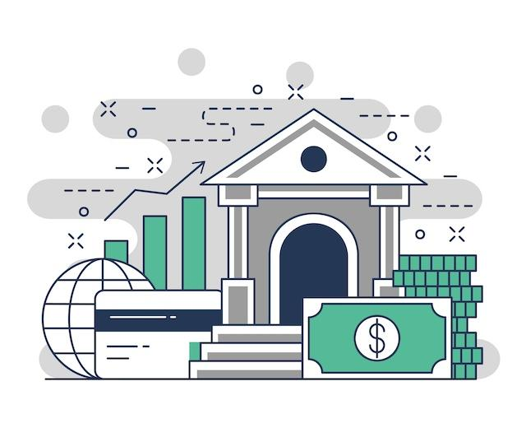
Bitcoin for Activism (Privacy & Human Rights)
The Weaponization of Banking Systems
When money becomes a weapon, it’s not guns but spreadsheets and policies that silence dissent.
Across Africa, traditional financial institutions have often been used to punish critics or control populations.
Common Tactics:
Account Freezes: Activists, unions, or journalists suddenly lose access to their funds during protests or political tension.
De-banking: NGOs and opposition groups are quietly removed from financial systems under “anti-terrorism” or “AML” regulations.
Transaction Censorship: Transfers flagged for political or humanitarian reasons are blocked by banks or mobile money operators.
Sanctions & Blacklists: Sometimes imposed by foreign governments, these measures often hurt ordinary citizens more than political elites.

Slide 9


Bitcoin for Activism (Privacy & Human Rights)
Case Examples from Africa
Nigeria: #EndSARS Movement (2020)
When young Nigerians took to the streets to protest police brutality, the government quickly moved to stifle the movement by freezing the bank accounts of key organizers.
Traditional fundraising channels were shut down.
Payment apps flagged protest-related donations as “suspicious.”
Response: The Feminist Coalition turned to Bitcoin donations, keeping the movement funded and operational.
“Bitcoin kept our movement alive when the system tried to silence us.” — Feminist Coalition

Slide 10


Bitcoin for Activism (Privacy & Human Rights)
Zimbabwe: Inflation as Oppression
Years of political mismanagement have turned money itself into a weapon in Zimbabwe.
The government printed excessive currency, leading to hyperinflation that wiped out savings and pensions.
Citizens were restricted from using USD, forcing them to hold rapidly devaluing Zimbabwean dollars.
NGOs and journalists reporting on corruption faced bank restrictions and audits.
Impact: Economic ruin became a method of control, survival depended on compliance.
Sudan: Protests and Sanctions
During years of political turmoil, international sanctions and government crackdowns left ordinary Sudanese people trapped.
Banks were disconnected from global networks, cutting off remittances.
Civil society organizations faced blocked funds under suspicion of “foreign influence.”
Impact: Financial isolation reinforced political control, leaving citizens dependent on state-approved systems.

Slide 11
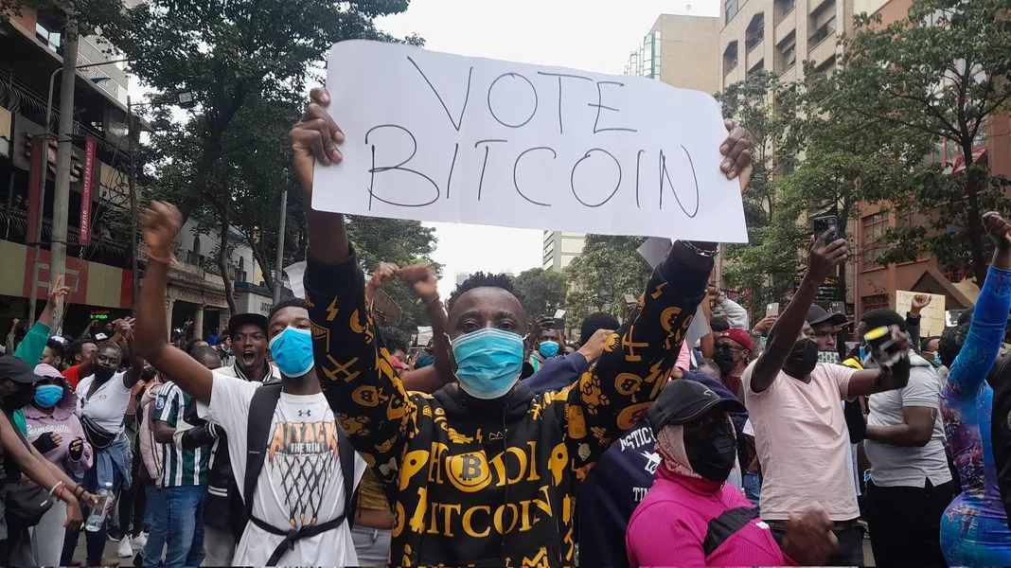
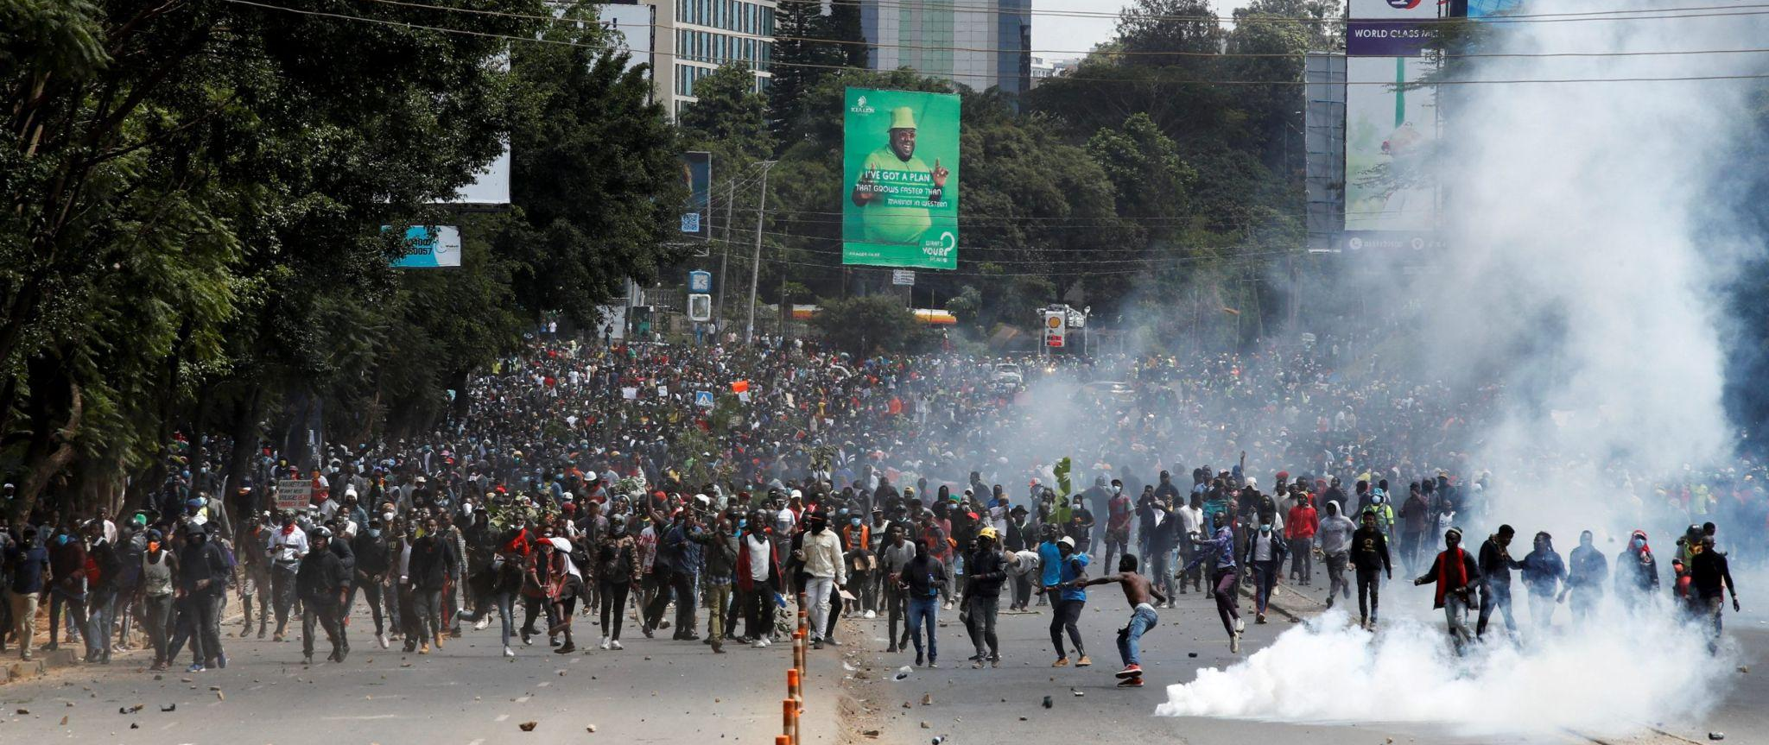
Bitcoin for Activism (Privacy & Human Rights)
Kenya: 2024 Finance Bill Protests
As the protests grew, the government responded not only with police force but also with financial suppression:
Bank account monitoring: Digital fundraisers supporting injured protesters and legal aid groups were flagged and delayed by banks under “security review.”
Mobile money interference: M-Pesa, Kenya’s dominant mobile payment system, became a tool of control. Several activists reported blocked or reversed transfers, especially those linked to protest support.
Digital shutdowns: Short-term internet disruptions and mobile service slowdowns were reported, hampering online coordination and digital fundraising.
When traditional systems failed, activists began exploring Bitcoin and other peer-to-peer tools to raise funds, pay for medical supplies, and support detained protesters. Bitcoin provided a neutral, unstoppable alternative to centralized platforms.

Slide 12
Bitcoin for Activism (Privacy & Human Rights)
Why Privacy Matters
Surveillance vs. Financial Freedom
In many African countries, governments claim surveillance is for “security” or “anti-terrorism.” But behind that claim lies a powerful truth: surveillance is control.
When authorities can monitor where your money goes, they can:
Predict your loyalties and networks.
Restrict your movement or freeze your accounts.
Intimidate you without ever making an arrest.
Financial surveillance is especially dangerous in Africa, where most payments go through centralized systems, banks, telecom operators (like M-Pesa in Kenya or MTN Mobile Money), and government-controlled ID systems.
These systems are efficient but not private. Every transaction leaves a trace on your identity, your location, your purpose, stored in databases often vulnerable to abuse or leaks.
In this environment, privacy is not about hiding wrongdoing; it’s about preserving dignity, safety, and autonomy.
“Privacy is not secrecy, it’s the right to exist without permission.”

Slide 13
Bitcoin for Activism (Privacy & Human Rights)
Risks of Being Tracked: Activists, Journalists, and NGOs
1. Activists
Activists often rely on donations and coordination tools to organize movements. Surveillance of these transactions allows authorities to:
Identify protest leaders and freeze their funds.
Track donors and intimidate supporters.
Shut down logistics like printing, transportation, or social media campaigns.
2. Journalists
Independent journalists rely on reader support and grants. Surveillance exposes their sources and compromises safety.
In Ethiopia and Uganda, reporters investigating government abuses have had bank transfers blocked or monitored.
Foreign funding to independent media is often portrayed as “subversive activity.”
3. NGOs
Nonprofits working in human rights, gender rights, or anti-corruption are frequent targets.
Governments can demand financial audits as a means of harassment.
Staff bank accounts may be frozen during investigations.
International payments may be delayed under “compliance review.”
These tactics make economic exhaustion a tool of repression.

Slide 14
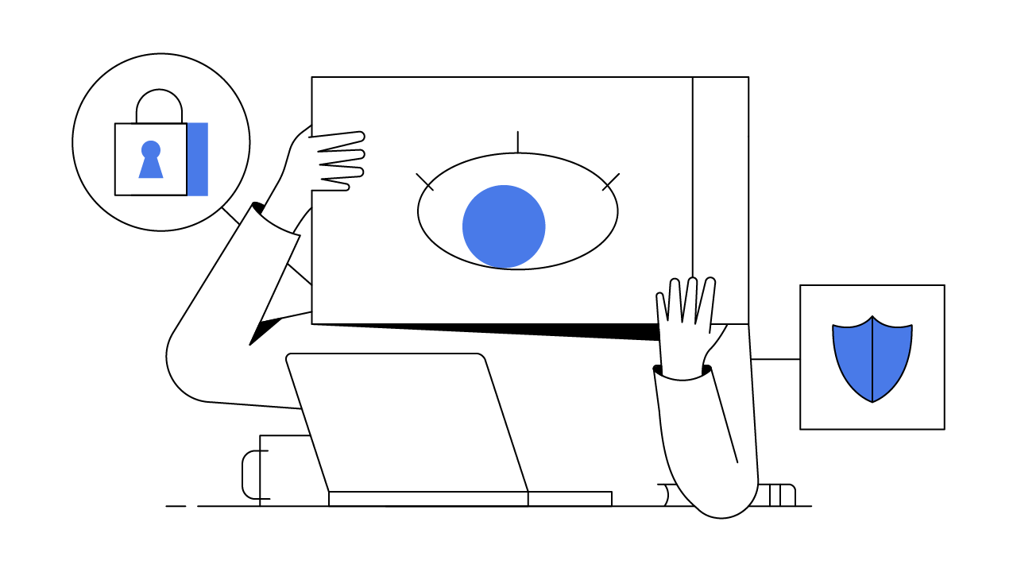
Bitcoin for Activism (Privacy & Human Rights)
Anonymity vs. Pseudonymity
Understanding the difference is essential in the Bitcoin era:
Bitcoin is pseudonymous, not anonymous. Every transaction is recorded on a public blockchain, visible to anyone. While your name isn’t shown, repeated use of the same address or linking your wallet to an exchange can reveal your identity.
For activists, this means privacy must be actively protected, not assumed.
Term | Meaning | Example
Anonymity | No one knows your identity at all. | Cash transactions between strangers.
Pseudonymity | You use an identity that hides your name but can still be traced through patterns. | Bitcoin addresses or usernames on social media.

Slide 15
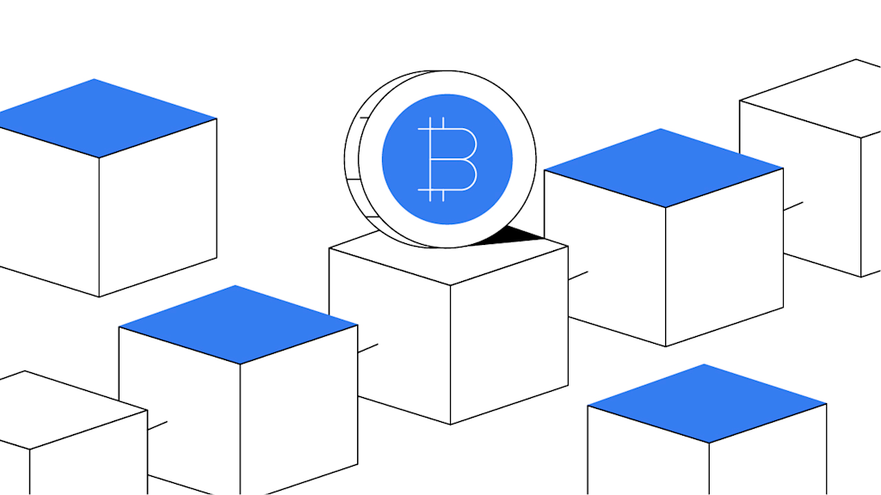
Bitcoin for Activism (Privacy & Human Rights)
Bitcoin’s Transparency (Blockchain) vs. Strategies to Protect Privacy
Best Strategies to Protect Privacy
Use New Addresses for Each Transaction: Avoid reusing Bitcoin addresses; it prevents others from linking multiple payments to you.
Avoid Sharing Wallet Screenshots or Public Keys Online: Even partial information can be used to track transactions.
Use CoinJoin or Collaborative Transactions: Tools like Wasabi Wallet or Samourai Whirlpool mix transactions to obscure history.
Use Lightning Network for Small or Frequent Payments: Lightning offers faster, cheaper, and more private payments than on-chain Bitcoin.
Use Non-KYC (Know Your Customer) Options Cautiously: Avoid platforms that require full identity verification when privacy is critical, but always balance safety and legality.
Secure Your Devices: A private transaction means nothing if your phone or computer is compromised. Use strong passwords, 2FA, and privacy browsers.
Bitcoin’s transparency is both a strength and a challenge:
It makes corruption and fraud harder because all transactions are public.
But it also exposes financial activity patterns that can endanger activists or NGOs if not handled carefully.

Slide 16
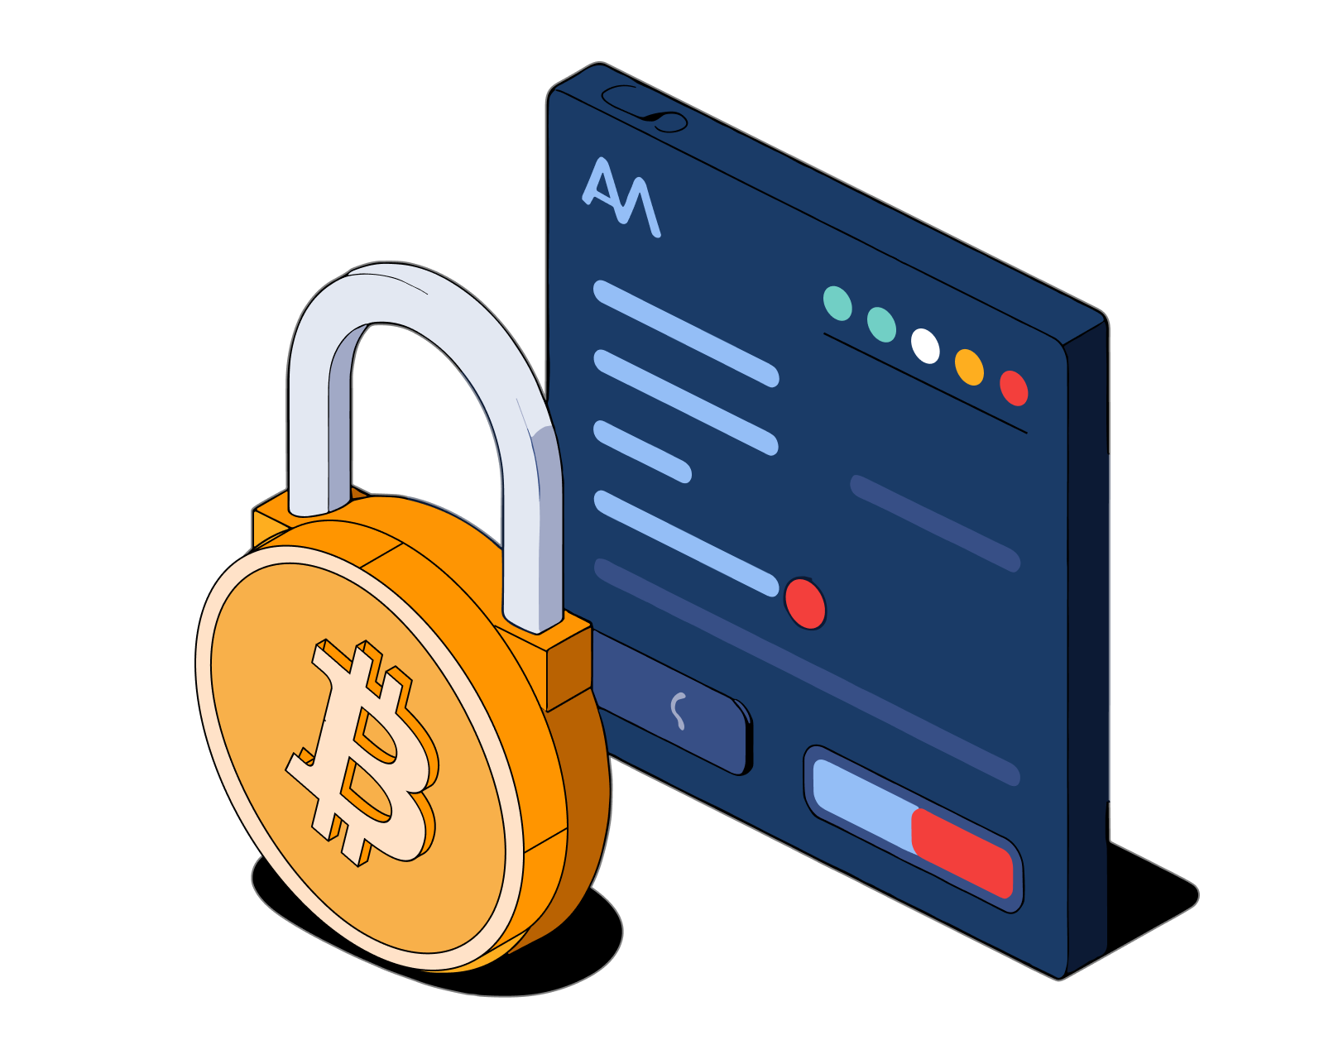
Bitcoin for Activism (Privacy & Human Rights)
Tools for Bitcoin Privacy
Bitcoin gives you financial freedom, but that freedom comes with responsibility, especially around privacy.
Every transaction you make is public, and if linked to your identity, it can expose your activity permanently.
For activists, journalists, and NGOs in Africa, this exposure can lead to harassment, blacklisting, or even state surveillance.
Understanding privacy tools is therefore not optional, it’s essential for safety and autonomy.
Freedom without privacy is just exposure. Bitcoin privacy tools turn digital courage into digital safety.

Slide 17
Bitcoin for Activism (Privacy & Human Rights)
1. Wallet Hygiene: Avoid Address Reuse
Each Bitcoin address can be compared to a receipt number on a public ledger.
Reusing the same address is like printing your name on every receipt you ever issue, anyone can trace your full transaction history.
Good Wallet Hygiene Practices
Always generate a new Bitcoin address for every incoming payment.
Use wallets that automatically create new addresses, such as BlueWallet, Muun, Phoenix, or Sparrow Wallet.
Avoid publicly posting donation addresses for long periods, rotate them periodically.
Never share your wallet’s extended public key (xpub), it can reveal all your balances and transactions.
2. Coin Control and UTXO Management
Each Bitcoin payment you receive creates a small “unspent transaction output”, known as a UTXO.
Think of UTXOs as individual envelopes of money stored in your wallet.
When you send Bitcoin, your wallet combines one or more envelopes to reach the amount you’re sending. If you don’t manage them properly, you can accidentally reveal more than intended.
Best Practices for Coin Control
Use wallets with coin control features (like Sparrow or Electrum).
Label UTXOs, e.g., “Donation,” “Personal,” or “Operational.”
Avoid mixing funds from different purposes.
When in doubt, send coins through a mixing process (CoinJoin) before reuse.

Slide 18
Bitcoin for Activism (Privacy & Human Rights)
3. CoinJoin & Collaborative Transactions
CoinJoin is a technique where multiple Bitcoin users combine their transactions into one large transaction, making it difficult to tell who sent what to whom.
This process breaks the traceability chain that surveillance companies and governments rely on.
Recommended CoinJoin Tools
Wasabi Wallet: Open-source desktop wallet offering easy CoinJoin with Tor integration.
Samourai Wallet + Whirlpool: Android wallet with strong privacy features and decentralized CoinJoin.
JoinMarket: For more technical users, it allows you to earn small fees while improving privacy.
Collaborative Transactions (without full CoinJoin):
PayJoin (P2EP): A collaborative transaction between sender and receiver that makes blockchain analysis less effective.
Batching: Combining multiple payments into a single transaction to reduce traceable outputs.
4. Lightning Network as a Privacy Tool
The Lightning Network is not only fast and cheap, it’s also more private.
Unlike Bitcoin’s base layer, Lightning transactions are not recorded on the blockchain; they happen off-chain between connected peers.
Privacy Advantages:
Payments are routed through multiple nodes, making it difficult to trace the sender or receiver.
There is no permanent record of small transactions.
Activists can use Lightning to receive donations privately and instantly.
Recommended Wallets:
Phoenix (by ACINQ): simple, self-custodial, and works well in Africa.
Breez Wallet: user-friendly and supports podcasting and invoicing.
Mutiny Wallet (browser-based): ideal for privacy-focused users.

Slide 19

Bitcoin for Activism (Privacy & Human Rights)
Responsible & Secure Use
Bitcoin offers freedom, but freedom without security becomes vulnerability.
Activists, journalists, and NGOs using Bitcoin in politically sensitive contexts must treat it like a powerful tool that can protect or expose, depending on how it’s handled.
Many movements have faced setbacks not because governments attacked Bitcoin, but because users failed to protect themselves.
This section explores how to use Bitcoin responsibly, safely, and collectively.
The strongest movement can fall apart with a single lost key or leaked address.

Slide 20
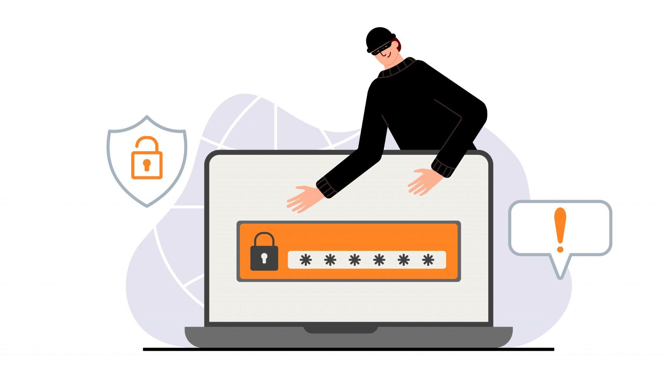
Bitcoin for Activism (Privacy & Human Rights)
1. Common Risks: Phishing, Scams & Poor Custody
Phishing Attacks
Phishing is when someone tries to trick you into giving up your private keys or wallet details through fake websites, messages, or apps.
Common Examples:
A fake exchange or wallet link sent via WhatsApp or Telegram.
Email claiming “Your wallet is locked, click here to restore access.”
Impersonation of well-known Bitcoin educators or donors.
Prevention Tips:
Always verify URLs before entering wallet information.
Bookmark official websites of wallets and exchanges.
Never click on links claiming to “recover lost funds.”
Use hardware wallets or air-gapped devices for long-term storage.

Slide 21
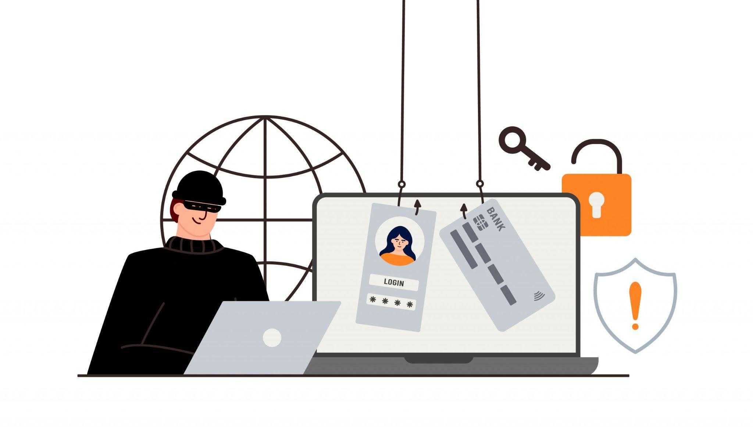
Bitcoin for Activism (Privacy & Human Rights)
1. Common Risks: Phishing, Scams & Poor Custody
Scam
Scammers exploit trust within activist or humanitarian networks.
They promise donations, trading profits, or quick fund transfers, but the goal is always to steal Bitcoin.
Key Warning Signs:
“Guaranteed returns” or “double your Bitcoin” schemes.
Anyone asking for your seed phrase or private key.
Social media giveaways or fake fundraising pages.
Golden Rule:
If someone asks for your private key or seed phrase, it’s a scam.

Slide 22
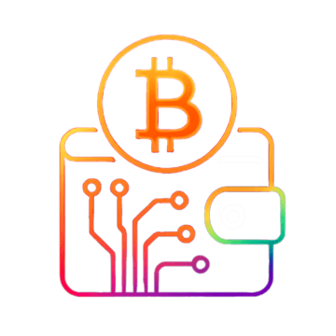
Bitcoin for Activism (Privacy & Human Rights)
1. Common Risks: Phishing, Scams & Poor Custody
Custody Practice
Poor Custody Practices
Even without scams, many users lose Bitcoin due to poor self-custody:
Writing seed phrases on easily lost papers.
Storing wallet backups on cloud drives.
Forgetting passwords or device PINs.
Best Custody Habits:
Write seed phrases on paper or metal backups.
Store them in two separate, secure locations.
Teach one trusted person how to recover funds if you are unavailable (especially for NGOs or community movements).
Avoid keeping large balances in mobile wallets used for daily transactions.

Slide 23

Bitcoin for Activism (Privacy & Human Rights)
2. Protecting Identities When Raising Funds
For activists and NGOs, privacy and transparency must be balanced.
While supporters may want proof of impact, publicizing Bitcoin addresses or personal names can endanger those involved.
Recommended Practices:
Use unique Bitcoin addresses for each donor or campaign.
Separate operational wallets from donation wallets.
Use pseudonyms or collective names for public fundraising.
Use privacy tools (CoinJoin, Lightning, Tor) when transferring donated funds.
Avoid posting real-time wallet balances on social media, it can attract unwanted attention or risk.

Slide 24
Bitcoin for Activism (Privacy & Human Rights)
3. Trade-Offs Between Convenience and Safety
Bitcoin offers multiple ways to hold funds, each with advantages and trade-offs.
Understanding these helps users choose based on context.
The rule is simple: The easier it is, the less secure it tends to be.
Activists should always prioritize safety over speed, especially when funds are mission-critical.
Method | Convenience | Security | Best For
Custodial Wallets (e.g., Wallet of Satoshi, Binance) | Very easy | Very low (company controls funds) | Small payments or beginners
Non-Custodial Mobile Wallets (e.g., Muun, Phoenix) | Easy | Moderate (user holds keys) | Everyday use
Hardware Wallets (e.g., Trezor, Coldcard, BitBox) | Medium | Very high | Long-term savings, organizational reserves
Multisig / Fedimint | Medium | Very high (shared trust) | Groups, NGOs, communities

Slide 25
Bitcoin for Activism (Privacy & Human Rights)
4. Community Custody Models (Fedimint & Multisig)
B. Fedimint (Federated Custody)
Fedimint allows communities to create their own Bitcoin “mini-bank,” where trusted members (called guardians) collectively manage custody and privacy.
It blends community trust with Bitcoin’s open system.
Advantages:
Combines privacy, accessibility, and collective security.
Protects users who may not yet be ready for full self-custody.
Works well in rural or community-driven Bitcoin circles.
Fedimint turns Bitcoin custody into a shared act of trust, the same way African communities have always done savings.”
Bitcoin gives you power, but with power comes
duty. Responsible use protects not only your money, it protects your movement
Sometimes, it’s risky for one individual to hold all the keys, especially in activist or NGO environments where one arrest or compromised phone could mean losing everything.
A. Multisig Wallets
“Multisig” means multiple signatures are required to move funds. For example, a 2-of-3 setup means 3 people hold keys, and any 2 must agree to send Bitcoin.
Benefits:
Prevents theft or misuse by one person.
Protects against loss (if one key is lost, others can recover funds).
Ideal for team-based funds or NGOs.
Tools:
Sparrow Wallet (desktop)
BlueWallet (mobile multisig)
Nunchuk (user-friendly and collaborative)

Slide 26



Q&A

Slide 27
THANK YOU

